Slide 1
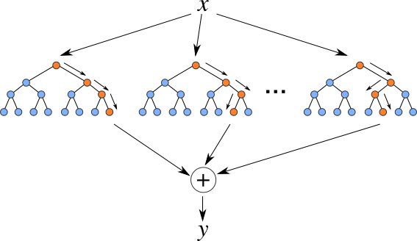
XGBoost
XGBoost stands for eXtreme Gradient Boosting
Additive tree model: add new trees that complement the already-built ones
Response is the optimal linear combination of all decision trees
Popular in Kaggle competitions for efficiency and accuracy

Slide 2
Why Use XGBoost?
.
Execution Speed
Model Performance

Slide 3
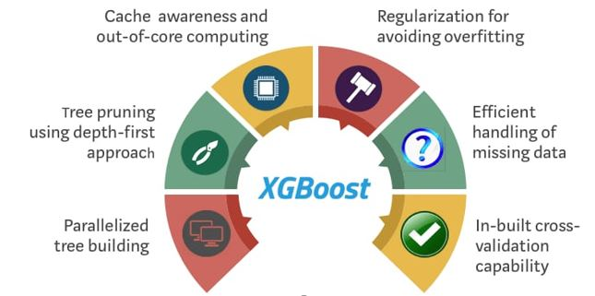
Features of Xgboost:

Slide 4
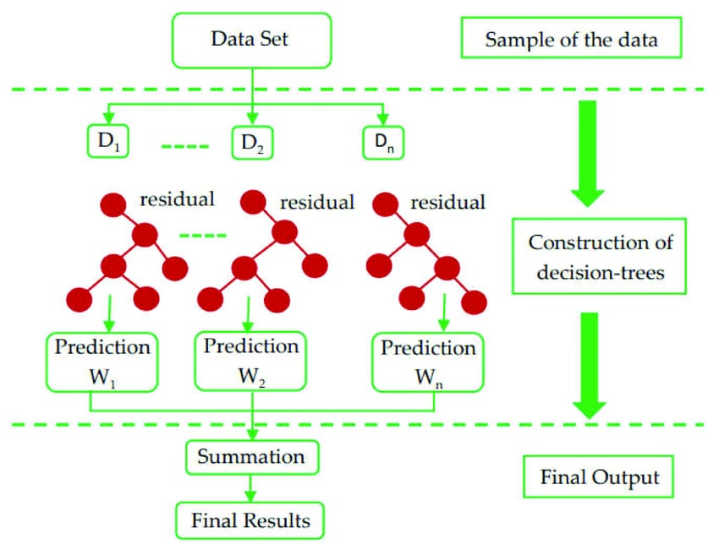
How XGBoost works:

Slide 5
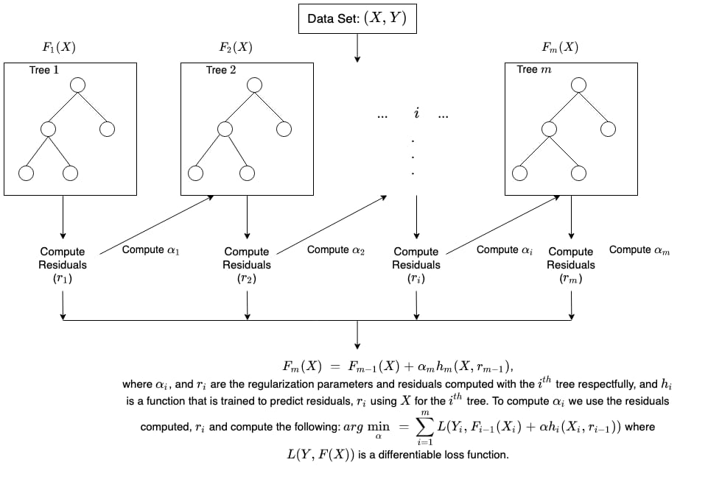
Mathametical Calculation:

